Slide 1
Database Systems
Lab 07

Slide 2
INTRODUCTION
Main objective to conduct this lab is to familiarized you with concept of views in sql. So, in the end of lab session students will be able to:
CREATE VIEWS IN SQL
DATA DICTIONARY IN ORACLE

Slide 3
Views in SQL
A view is a “virtual” table that is derived from other tables
Allows for limited update operations
Since the table may not physically be stored
Allows full query operations
A convenience for expressing certain operations

Slide 4
Specification of Views
SQL command: CREATE VIEW
a table (view) name
a possible list of attribute names (for example, when arithmetic operations are specified or when we want the names to be different from the attributes in the base relations)
a query to specify the table contents

Slide 5
SQL Views: An Example
Specify a different WORKS_ON table
CREATE VIEW WORKS_ON_NEW
AS
SELECT EMPNO,ENAME , COMM
WHERE DEPTNO = 20 AND
COMM IS NULL;

Slide 6
Using a Virtual Table
We can specify SQL queries on a newly create table (view):
SELECT ENAME
FROM WORKS_ON
WHERE ENAME LIKE ‘A%’;
When no longer needed, a view can be dropped:
DROP VIEW WORKS_ON_NEW;

Slide 7
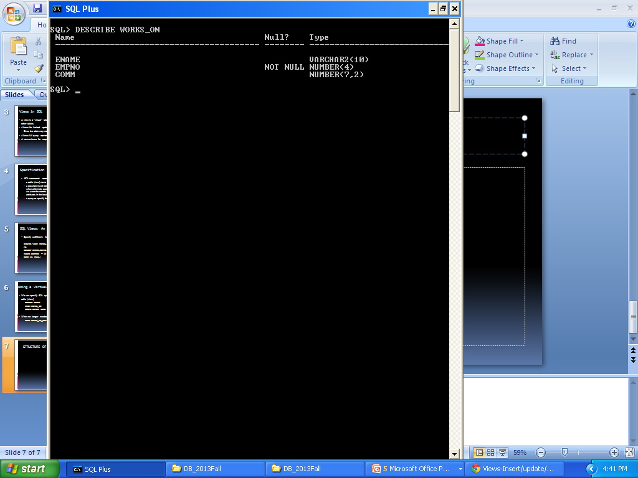
STRUCTURE OF VIEW

Slide 8
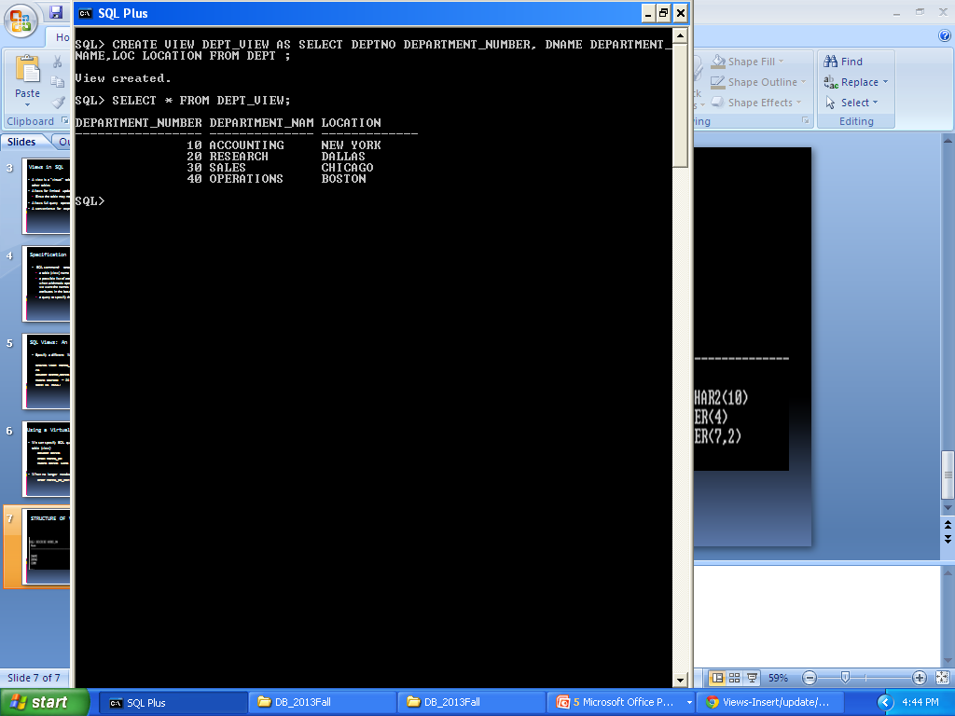
CREATING VIEW USING COLUMN ALIASES

Slide 9
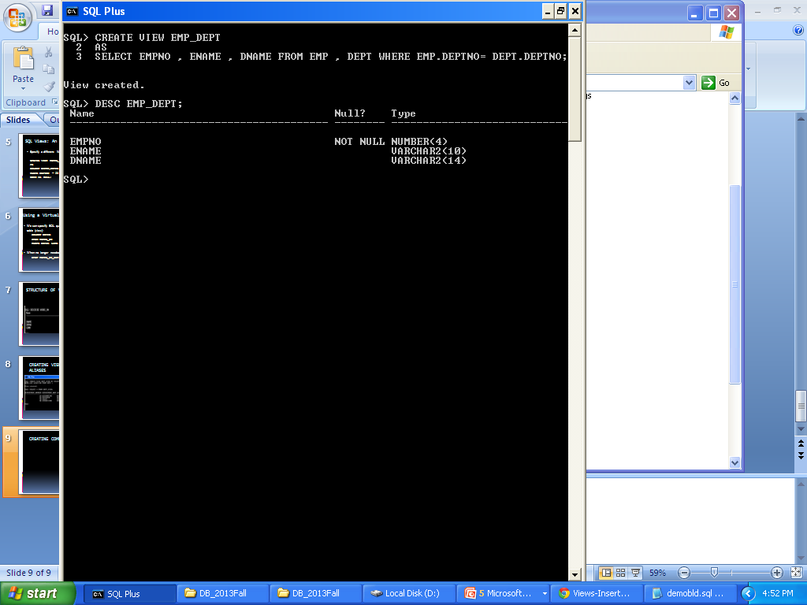
CREATING COMPLEX VIEWS
SYNTAX:

Slide 10
DATA DICTIONARY
Metadata is data about data, or data that defines other data. The Oracle data dictionary is metadata about the database. For example, if you create a table in Oracle, metadata about that table is stored in the data dictionary. Such things as column names, length, and other attributes are stored. Thus, the data dictionary contains a great volume of useful information about your database. Pretty much everything you would want to know about your database is contained in the data dictionary in some form.

Slide 11
ARCHITECTURE OF DATA DICTIONARY
The data dictionary is created when the Oracle database is created. It is owned by the SYS user.
The data dictionary views come in three main flavors:
* User views
* All views
* DBA views

Slide 12
USER’S VIEW
SELECT
table_name
FROM
user_tables;

Slide 13
ALL_VIEW
SELECT
table_name
FROM
all_tables;

Slide 14
DBA_VIEW
SELECT
table_name
FROM
all_tables;

